Slide 1
Composing Music Application for iOS Project proposal presentation
Mr.Kanapod Saenkasemsakul 542115011
Miss.Unyamanee Gedjaroen 542115072
Project Advisor
Mr.Kittitouch Suteeca

Slide 2
Overview
Introduction
Problem
Solution
Application Review
List of Feature
System Architecture
Technology Reviews
Development Tools Review
Limitation
Quality Assurance
Development Model
Schedule & Milestone

Slide 3

Introduction
This application is to develop application on iOS that can help people convenient to compose song and share it in the application for other people that use this application can be listen and comment it.

Slide 4
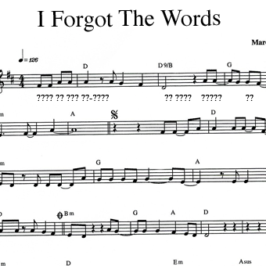



Problem

Slide 5

Solution
Mobile Application
Portable
Comfortable

Slide 6
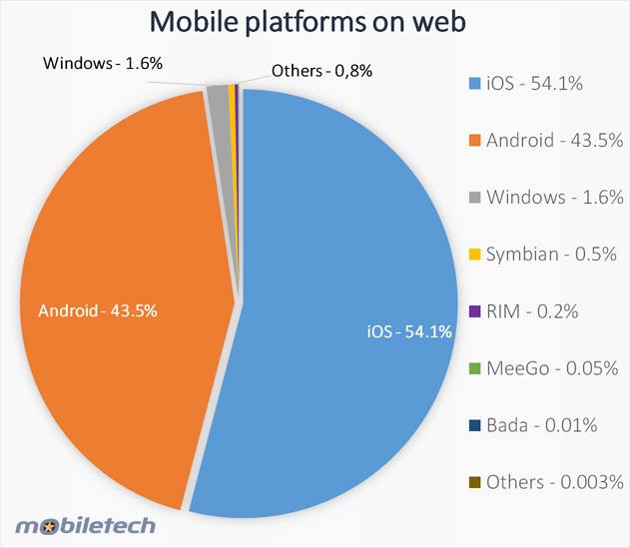
Solution
iOS and why iOS?
Popular
iOS provide iPhone, iPod, iPad

Slide 7
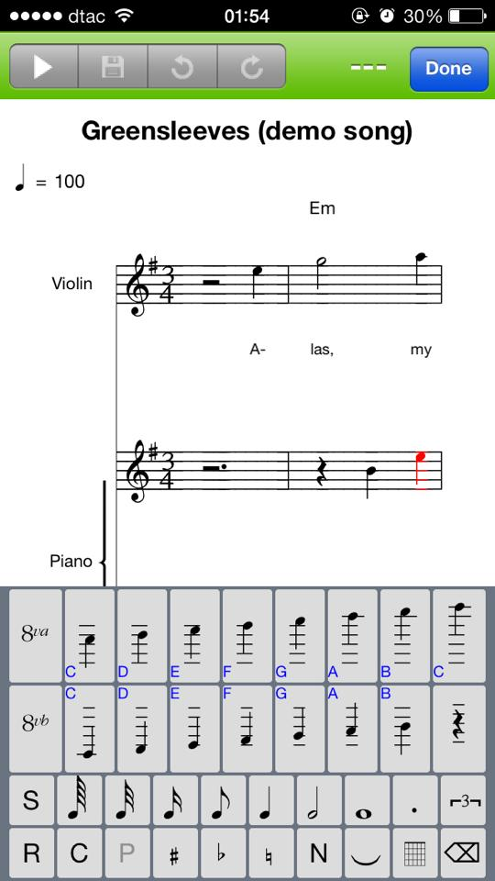
Software Review
Score Creator
Developed for iPhone
Compose song application

Slide 8
List of Feature
Feature #1 user management system.
Feature #2 the album management system.
Feature #3 compose song system.
Feature #4 music management system.
Feature #5 E-Learning system.

Slide 9
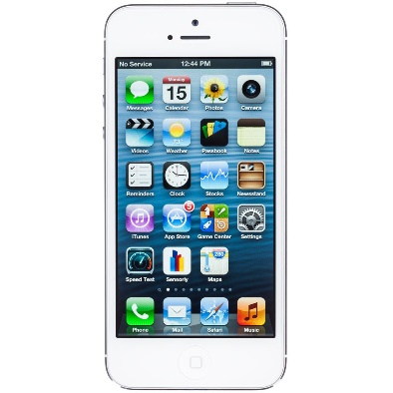


System Architecture
Add Data
Transfer Data
Database
Application
Send Data
Server

Slide 10


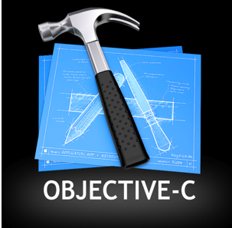

Technology Review

Slide 11
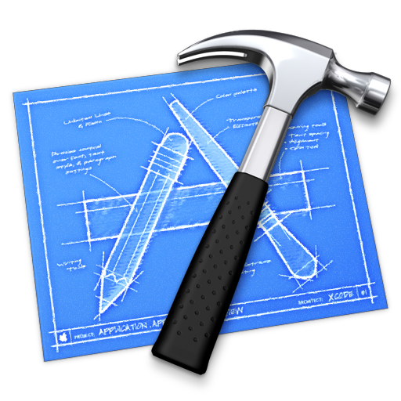



Development Tools Review

Slide 12
Limitation
The application requires Internet connection to execute.
The application requires login before using all functions in the application.
The application requires only in iOS.
The application could not share song via third party social network.
The application doesn’t allow member to download a song from the application.
The application could not connect with any music instrument hardware.

Slide 13
Quality Assurance
ISO29110 for Very Small Entity (VSE)
The basic VSE Profile Management and Engineering Guide applies to a very small Entity (VSE) is a standard that can control the quality of enterprise, organization, department or project up to 25 people. The guide provides Project Management process and Software Management process that use to improve the quality standard of the small enterprise.
Provide 2 processing following:

Slide 14
Quality Assurance
Software Implementation process
- Software Implementation Initiation Process
- Software Requirements Analysis Process
- Software Architectural Design Process
- Software Construction Process
- Software Integration and Test Process
- Software Delivery Process

Slide 15
Quality Assurance
Project Management process
- Project Planning Process
- Project Plan Execution Process
- Project Assessment and Control Process
- Project Closer Process

Slide 16
Development Model
Iterative Model
Software Requirement Specification
Software design
Test Plan
Implementation
Test progress
Proposal Document
Progress 1

Slide 17
Development Model
Iterative Model
Software Requirement Specification
Software design
Test Plan
Implementation
Test progress
Software Requirement Specification
Software design
Test Plan
Implementation
Test progress
Progress 2
Progress 3

Slide 18
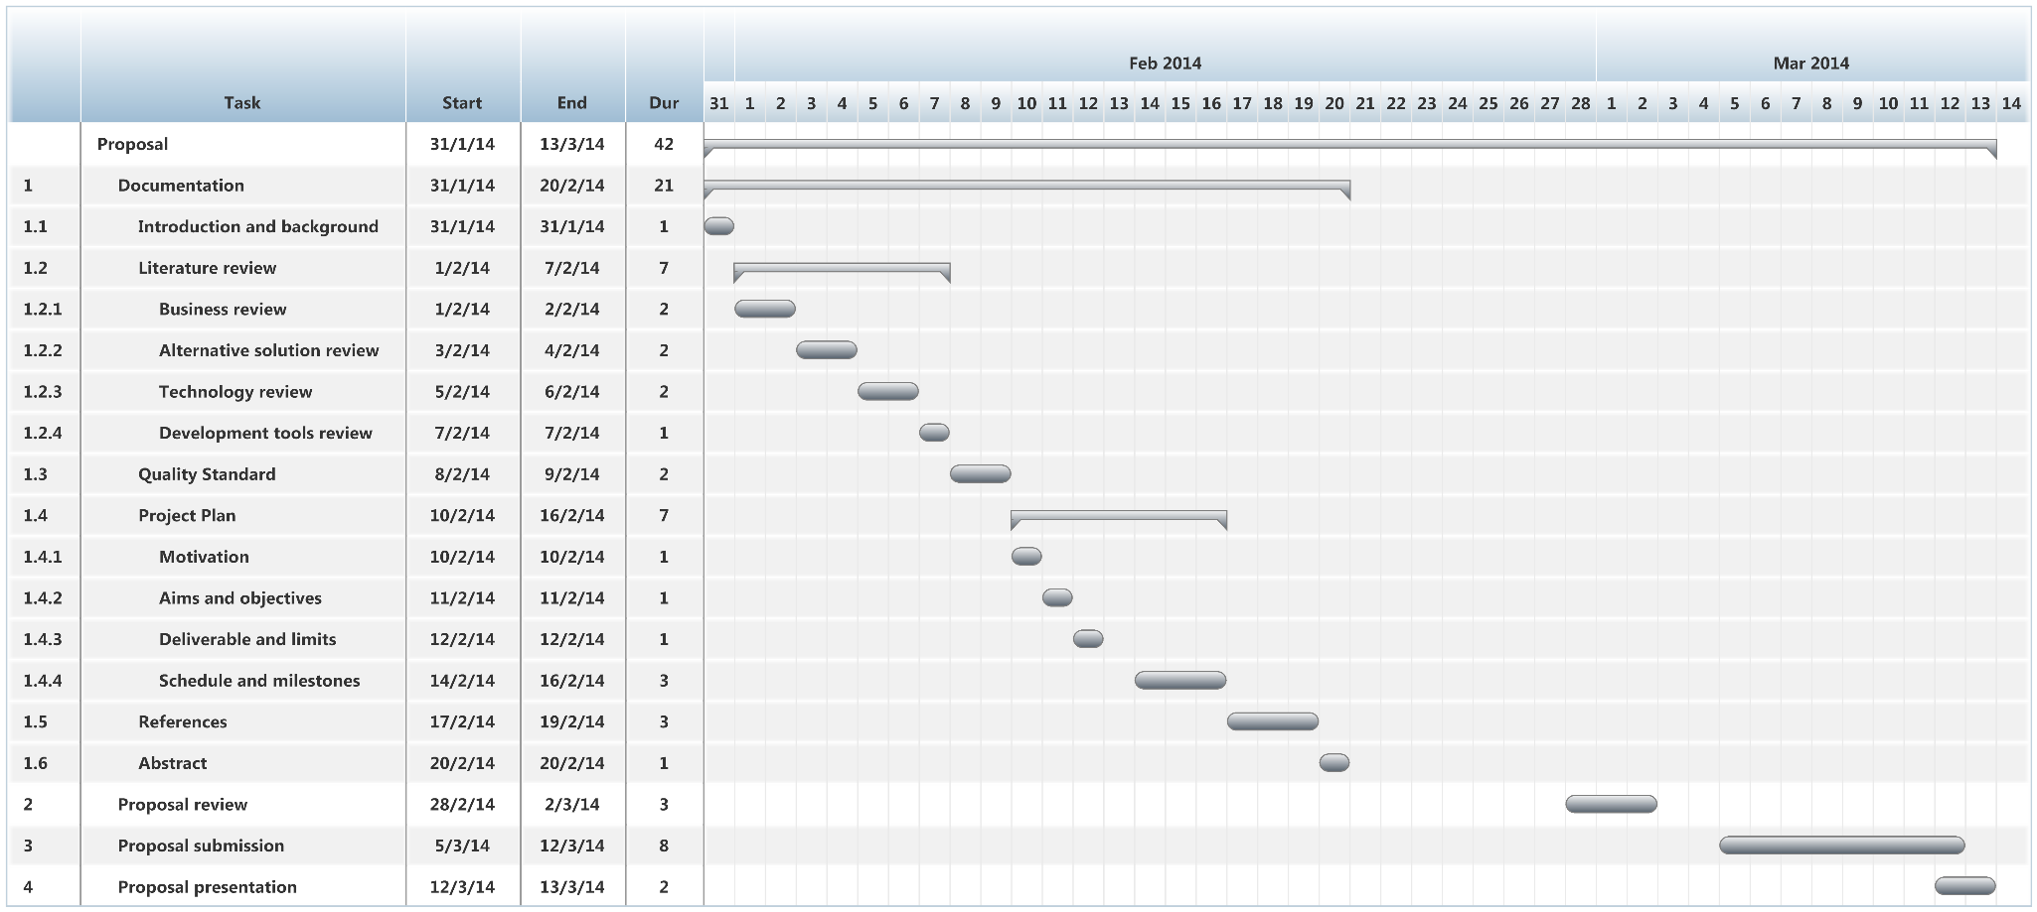
Schedule & Milestone
Proposal - Create proposal document

Slide 19
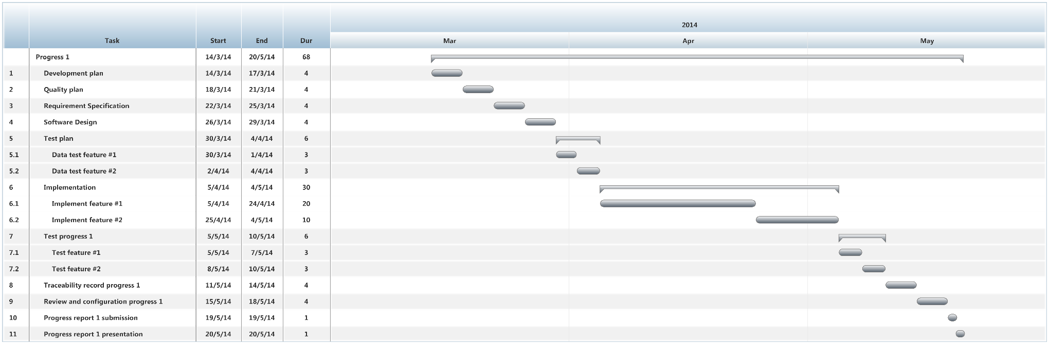
Schedule & Milestone
Progress 1 - Create Development plan, Quality plan, SRS, URS, SDD, and some part of Test document. Start create feature #1 and #2 of the system.

Slide 20
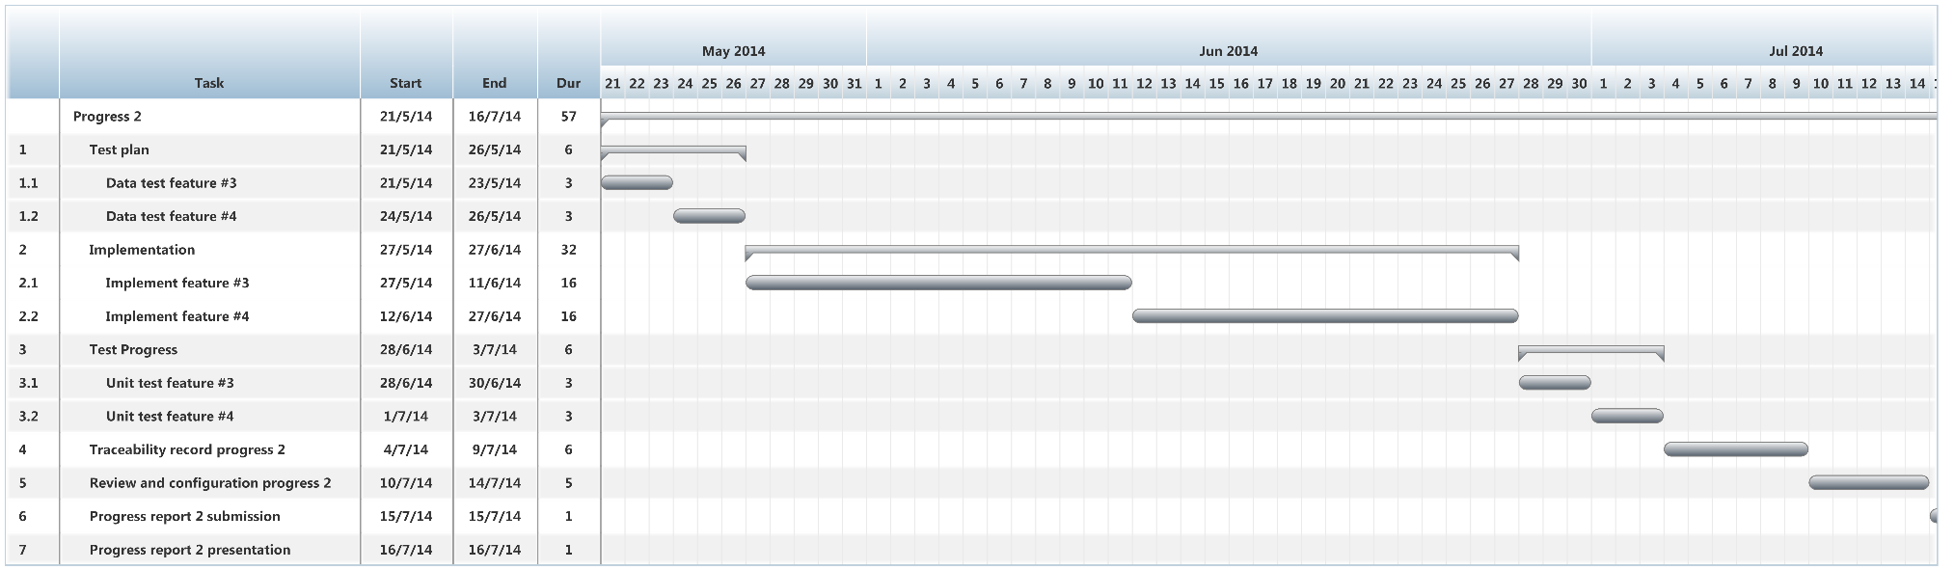
Schedule & Milestone
Progress 2 - Create feature #3 and #4 of the system, overall should be higher than 75%. Continue on Test document.

Slide 21
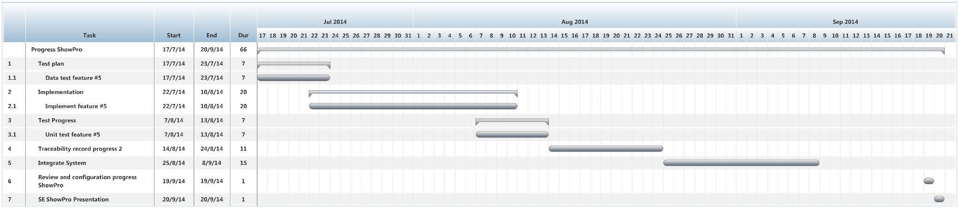
Schedule & Milestone
ShowPro - Create feature #5 of the system and integrate all feature. Overall of the system should be complete. Continue on Test document.

Slide 22
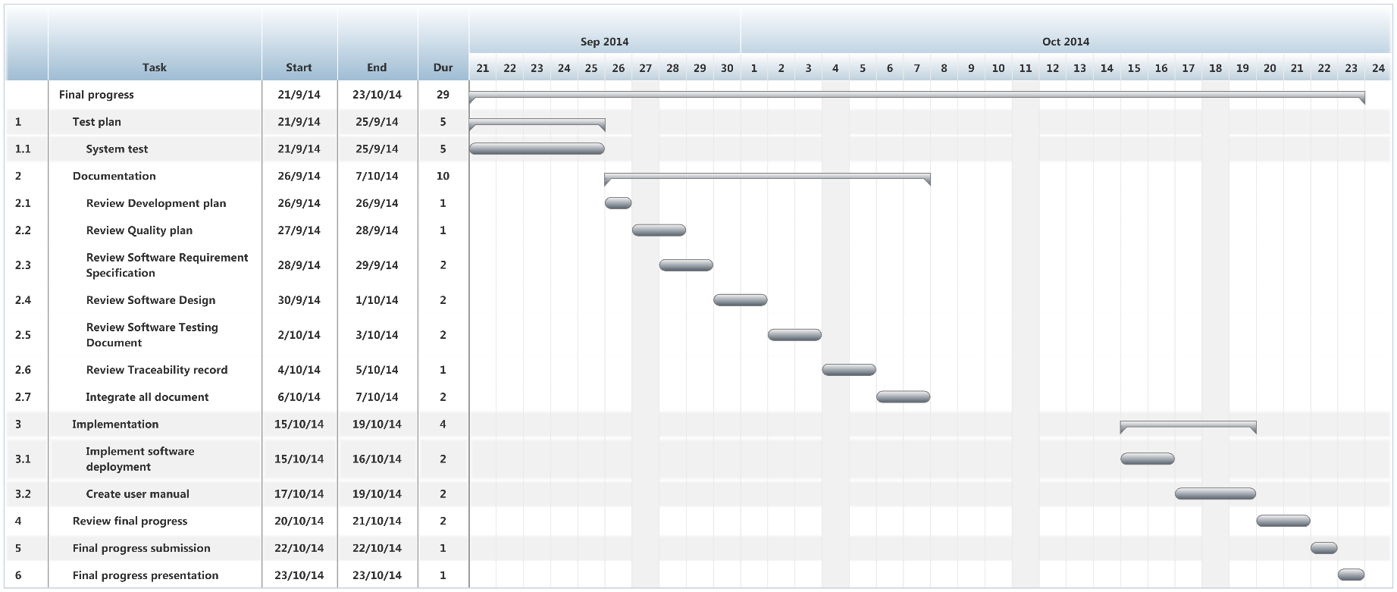
Schedule & Milestone
Final Progress - Integrate and review all of document. Make sure all system and document are complete.

Slide 23
Q&A

